Slide 1

A MENTAL HEALTH CLASSIFICATION MODEL USING DEEP LEARNING AND NLP
Name :- Patel Vedant Vikrambhai
R.g.no :- 20BCE1779
Guide :- DR. Vinothini A

Slide 2
Outline
No. | Title | Slide Number
1 | Introduction | 3
2 | Problem Statement | 4
3 | Research Objective | 5
4 | Proposed System | 6
4.1 | Proposed System Introduction | 7
4.2 | Proposed System Diagram | 8
4.3 | List of Modules | 9
4.4 | Explanation of Modules | 10-20
5 | 100% Implementation with the result | 21-27
6 | Conclusion and Future Work | 28-29
7 | Guide Approval mail Screenshot | 30
8 | Research paper status | 31
9 | References | 32-34

Slide 3
Introduction
Studies reveal that shame and self-stigmatization were the main reasons for not seeking psychiatric help for depression.
However, recent advances in technology especially in natural language processing (NLP) have presented the world with various application-based and online diagnosis tools where the patient can be diagnosed from the comfort of their own home.
Woebot, Wysa, Joyable, and Talkspace are a few examples of chatbots that are available as Android/iOS apps or websites that can perform mental health assessments using natural conversation.
Although these systems are good at providing general therapeutic advice, they do not replace the role of a psychiatrist.
However, such systems allow preventive measures and early diagnosis of mental health issues to avoid their increasing severity. self-stigmatization.

Slide 4

Problem Statement
Sentiment analysis algorithms and conversational agents are being leveraged to create a supportive platform that encourages individuals to share their emotional concerns. The project is developed an Ai based system that could classify the emotion of humans into various mental health disorders.
The goal is to integrate cutting-edge technology with mental health care to promote early intervention and improve mental health outcomes for individuals worldwide.

Slide 5
Research Objective
To design an AI model by using sequence modeling in NLP to classify user written text into various categories of mental health issues.
Deploy the development AI model in real time environment.

Slide 6
Proposed System
Data collection and annotation: The first step is to collect a large dataset of text data that will be used to train the T5 model. This involves collecting data from a variety of sources, such as social media, online forums, and healthcare records, and annotating it with labels that indicate the presence or absence of each mental health issue.
Preprocessing: The collected text data must be preprocessed to remove noise, standardize language use, and convert it into a format that can be used by the T5 model. This may involve techniques such as tokenization, stemming, and lemmatization.
Model development: The T5 model is then developed using the preprocessed text data. This involves selecting appropriate hyperparameters, training the model on the labeled data, and evaluating its performance using appropriate metrics such as precision, recall, and F1 score.
Deployment: Once the T5 model has been developed and evaluated, it can be deployed in a production environment. This may involve integrating the model into an existing mental health screening tool, developing a standalone application, or integrating it into an electronic health record system.

Slide 7
Proposed System Introduction
This work aims to utilize deep learning models to classify user-provided natural language descriptions of mental health conditions into predefined groupings.
The data utilized for the experiment includes the ground truth category and a text description of mental health conditions. Text processing methods from NLP were applied to the text sample and deep learning techniques were constructed. This study also delves into the classification of natural language descriptions of mental health issues using two distinct models: T5 and Long-Term Bidirectional Memory (Bi-LSTM).
Leveraging the T5 model, a transformer-based architecture, sequential information is extracted from textual data to classify mental health descriptions into predefined categories. The T5 model demonstrates promising results, achieving an accuracy of 86% of the rougelsum score before overfitting, showcasing its potential for improved performance with larger datasets.
However, the Bi-LSTM model also proves effective in this classification task, achieving an accuracy of 74% before overfitting. Attempts to apply transfer learning using BERT on the same dataset yielded suboptimal results, highlighting the importance of selecting appropriate models for small-scale datasets.
This research underscores the efficacy of both T5 and Bi-LSTM models in mental health classification tasks and underscores opportunities for further investigation, particularly in training more advanced models on larger datasets.

Slide 8
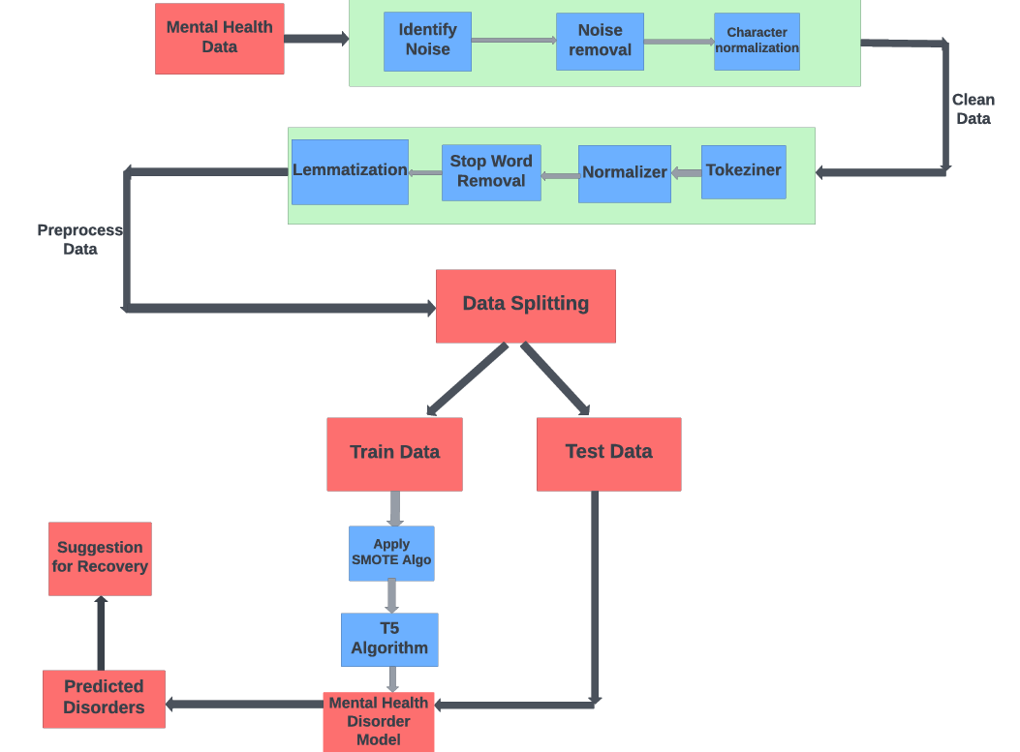
Proposed System Diagram Figure. 1 Proposed System Diagram

Slide 9

List of Modules
1. Data Collection and Preprocessing
Word embedding
Tokenization
Stemming
Lemmatization
Part of speech tagging
Normalizer
Stop words Removal
2. Model Training
3. Hyperparameter Tuning
4. Performance Evaluation

Slide 10
Modules
1. Data Collection and Preprocessing:
Data Collection: Gather a diverse dataset containing text samples related to mental health. This can include forums, social media posts, clinical notes, etc.
Text Cleaning: Preprocess the text data by removing irrelevant information, special characters, and performing tasks like stemming or lemmatization.
Tokenization: Break down the text into individual words or tokens.
Word Embeddings:
Word Embedding Layer: Convert words into numerical vectors to represent semantic relationships. Techniques like Word2Vec, GloVe, or pre-trained embeddings (e.g., Word2Vec, GloVe, or embeddings from transformer models like BERT) can be used.

Slide 11
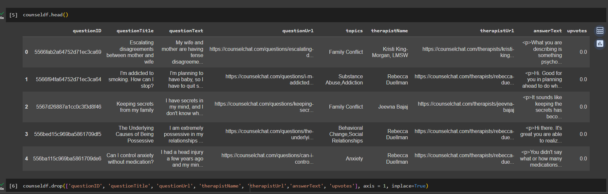
Modules Figure. 2 Top 5 dataset attributes

Slide 12
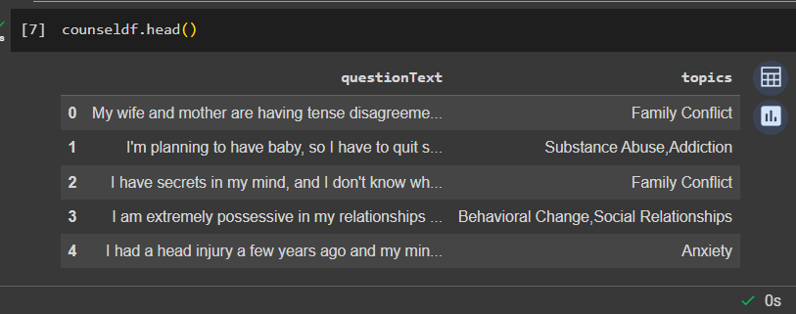
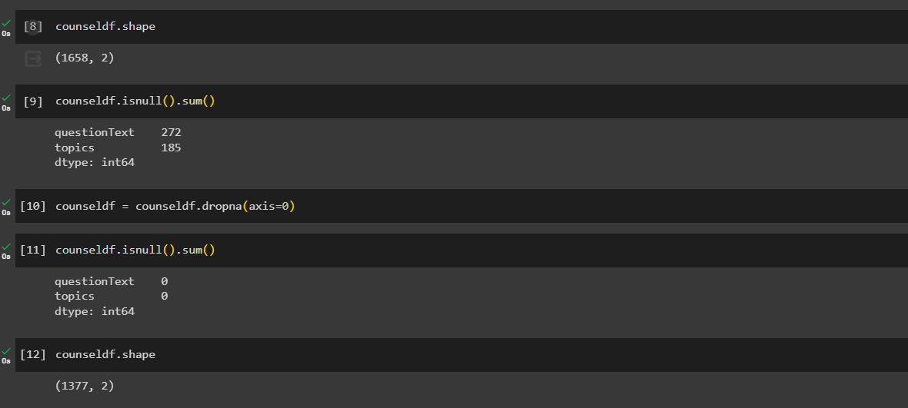
Modules Figure. 3 Top 5 attributes of dataset after clean dataset

Slide 13
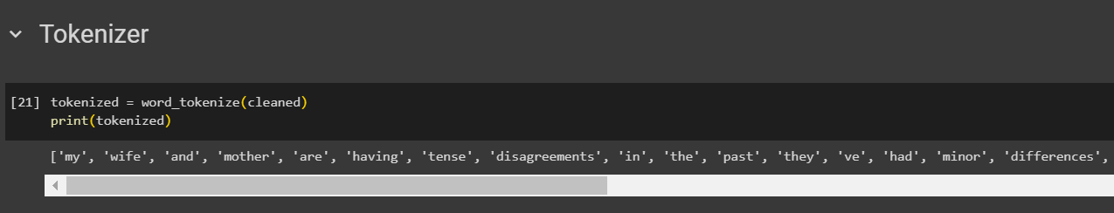
Modules
Tokenization
Tokenization breaks text into smaller parts for easier machine analysis, helping machines understand human language. Tokenization, in the realm of Natural Language Processing (NLP) and machine learning, refers to the process of converting a sequence of text into smaller parts, known as tokens.
Figure. 4 Tokenization Process

Slide 14
Modules
Stemming
Stemming is a technique used to extract the base form of the words by removing affixes from them. It is just like cutting down the branches of a tree to its stems. For example, the stem of the words eating, eats, eaten is eat.
Lemmatization
Lemmatization is a text pre-processing technique used in natural language processing (NLP) models to break a word down to its root meaning to identify similarities. For example, a lemmatization algorithm would reduce the word better to its root word, or lemme, good.
Part of speech tagging
The process of marking up a word in a text (corpus) as corresponding to a particular part of speech, based on both its definition and its context.

Slide 15
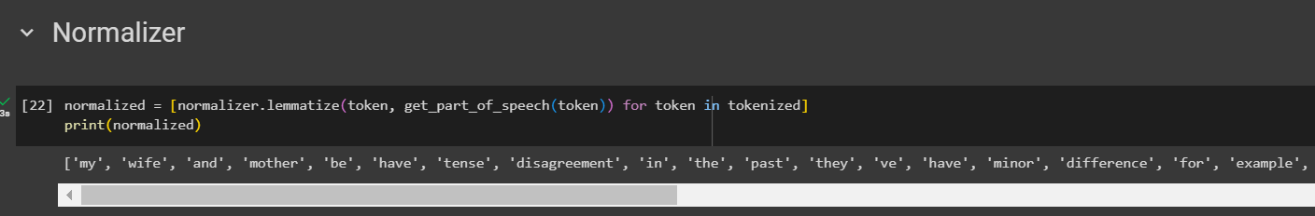
Modules
Normalizer
Normalization helps you keep your database organized. It reduces the duplication of data and improves its integrity. In its first normal form, the relation consists of unique values with no-repeat values. The second normal form eliminates all partial dependencies.
Figure. 5 Normalization Process

Slide 16
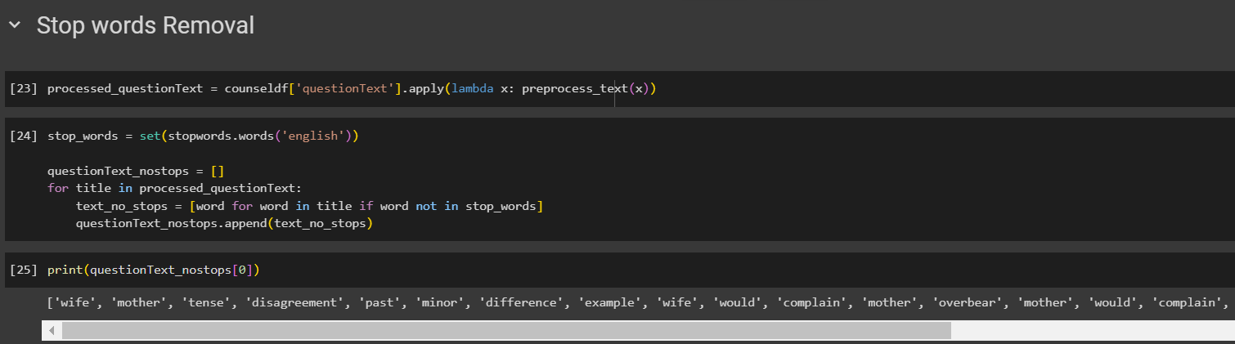
Modules
Stop words Removal
The idea is simply removing the words that occur commonly across all the documents in the corpus. Typically, articles and pronouns are generally classified as stop words.
Figure. 6 Stop Words Removal Process

Slide 17
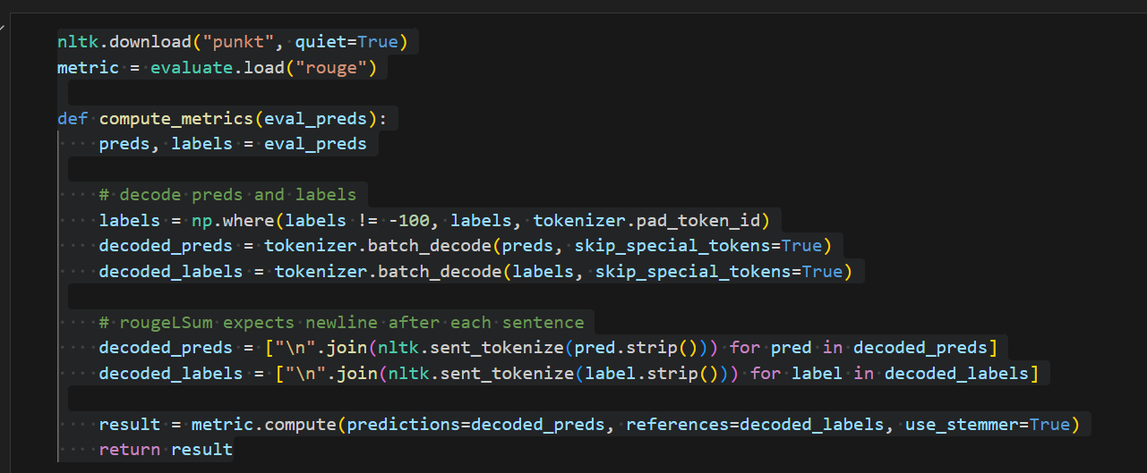
Modules
2. Model Training:
Loss Function: Define a suitable loss function for your classification task (e.g., binary cross-entropy for binary classification or categorical cross-entropy for multi-class classification).
Optimizer: Choose an optimizer such as Adam or RMSprop.
Training: Train the model on your dataset, monitoring performance on a validation set.
Figure. 7 Model Building

Slide 18
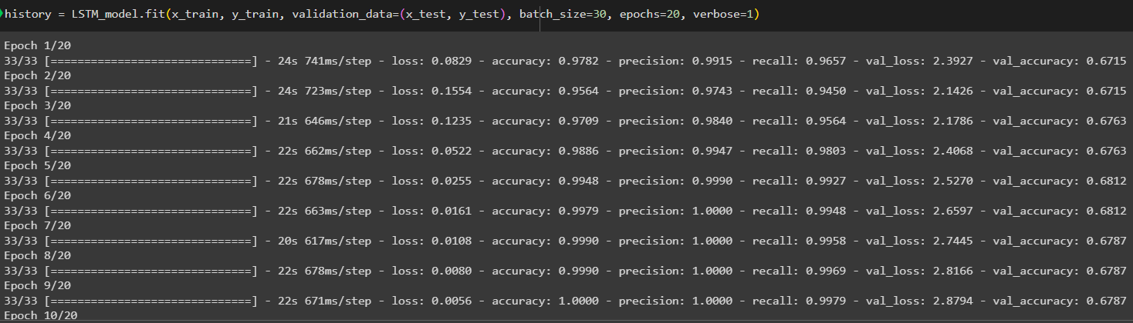
Modules
3. Hyperparameter Tuning:
Grid Search or Random Search: Experiment with different hyperparameter values (e.g., learning rate, dropout rate units) to optimize model performance.
Figure. 8 Model’s Epochs

Slide 19
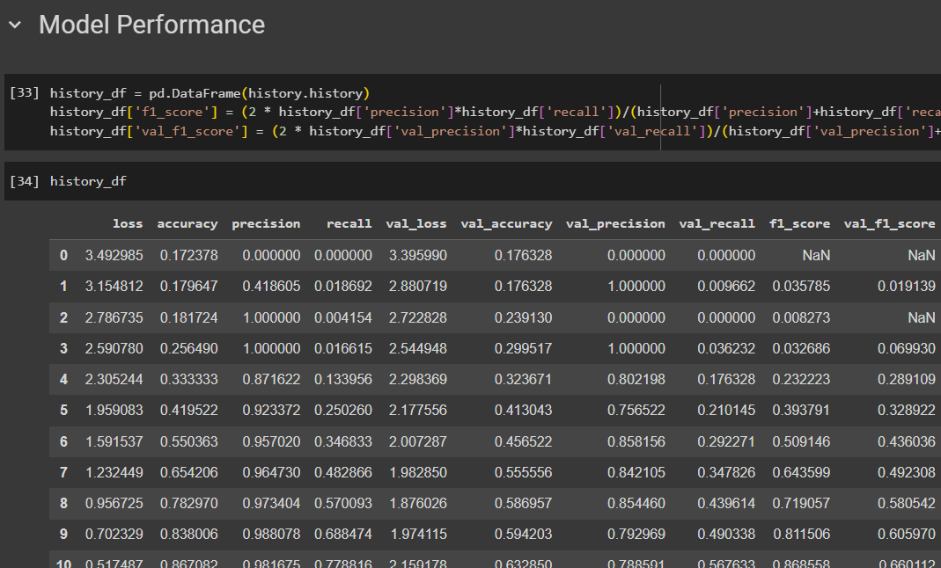
Modules
4. Evaluation Metrics:
Accuracy, Precision, Recall, F1 Score, Rougescore: Evaluate the model's performance using appropriate metrics for classification tasks.
Confusion Matrix: Analyze false positives, false negatives, true positives, and true negatives.
Figure. 9 Model Performance

Slide 20
Modules
Rouge1
ROUGE-1 (also known as ROUGE-N) is one of the ROUGE metrics that focuses on unigrams like individual words. It calculates the overlap of unigrams between the system-generated summary and the reference summary.
Rouge2
Within the ROUGE family, ROUGE-2, or ROUGE-Bigram, is another metric that is used to assess the quality of summarization results. ROUGE-2 assesses the overlap of bigrams (pairs of consecutive words) between the reference summary and the system-generated summary, in contrast to ROUGE-1, which concentrates on unigrams.
Rougel
An additional ROUGE family measure for assessing the caliber of summarization outputs is ROUGE-L The longest common subsequence (LCS) between the reference summary and the system-generated summary is measured.

Slide 21
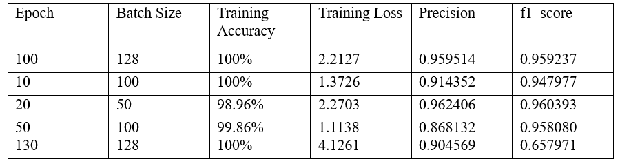
Implementation and Result
LSTM training
LSTM Model Result
Table 5.1 Training an LSTM model using different epoch and batch size
The results of training an LSTM model with various batch sizes and epoch configurations are shown in Table 5.1. With the "Epoch" column representing the number of iterations over the dataset and the "Batch Size" column indicating the amount of data points processed in each training phase, each row represents a distinct training scenario. The proportion of correctly identified cases during training is shown in the "Training Accuracy" column, while the model's inaccuracy in predicting outputs in comparison to actual values is measured in the "Training Loss" column. Higher values in the precision and F1 Score measures indicate better performance and accuracy of the model's predictions overall.

Slide 22
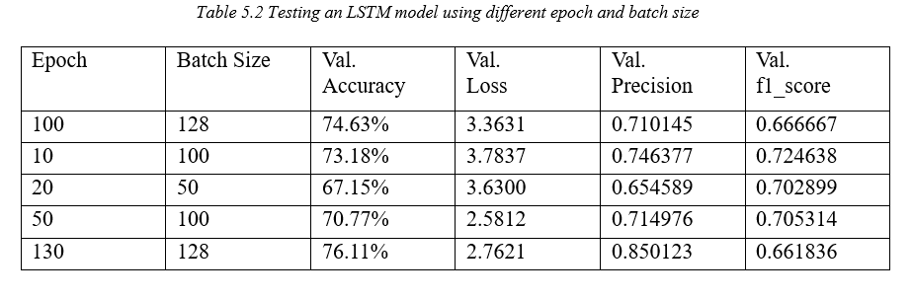
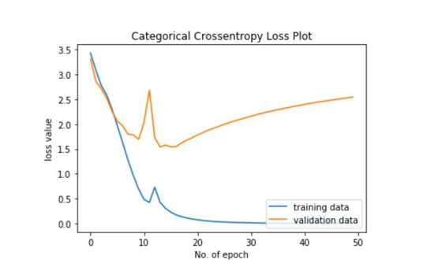
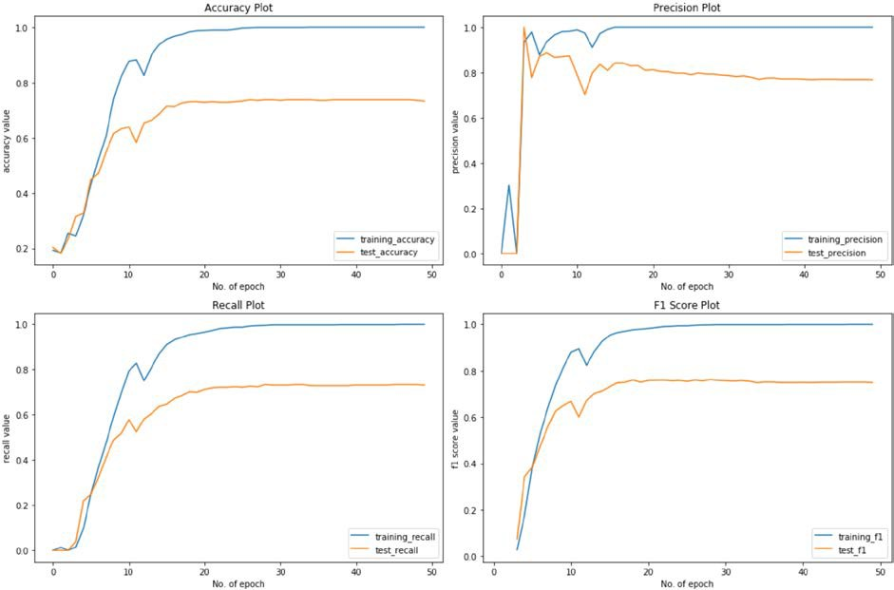
Fifty epochs were used to train the model. Training accuracy rose steadily until it attained 100%. Nonetheless, the test's accuracy leveled off at roughly 70%. Considering the magnitude of the dataset, this is an excellent outcome. Since the network will have more word tokens to rely on, the test accuracy may rise even further with additional data. Table 5.2 displays the graph for the loss plot. This picture illustrates how, shortly before the 20th epoch, the model begins to overfit to the training set.

Slide 23
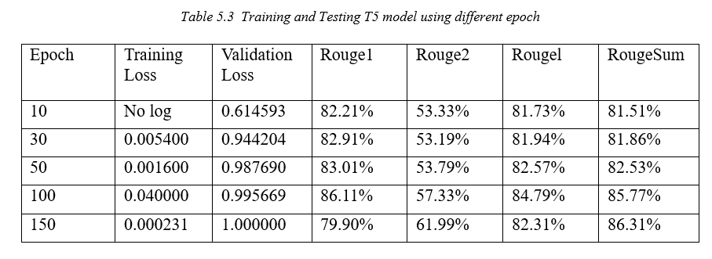
T5 training
T-5 Model Result Table
The performance of a T5 model trained over different epochs is shown in the table 5.3. It displays the validation loss (error during validation), training loss (difference between the model's predictions and the real data during training), and Rouge scores (metrics assessing the quality of text summarization produced by the model) for each epoch. The longest common subsequence is measured by RougeL, the overlap of bigrams is measured by Rouge2 and the overlap of unigrams by Rouge1, and the average of these three measures is called RougeSum. The results show that the Rouge scores show constant performance in producing summaries that closely resemble reference summaries, and this model got 86.11%.
When the model ran with 100 epochs it got 0.04 training loss, 0.99 validation loss, 86.11% rouge1 score, 57.33% rouge2 score, and 85.77% rougesum score which is better the accuracy.

Slide 24
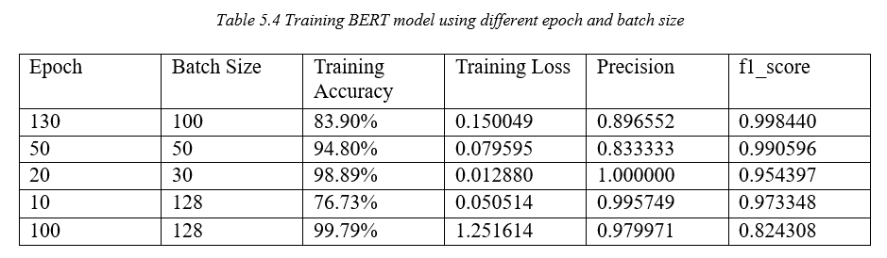
BERT training
BERT Model Result Table
To investigate the effects of different combinations of epochs and batch sizes on model performance, table 5.4 presents the results of BERT model training. For example, the training accuracy was 83.90% at 130 epochs with a batch size of 100, and the training loss was 0.150049. The measures for precision and F1 score were likewise excellent, coming in at 0.896552 and 0.998440, respectively. On the other hand, training accuracy increased to 99.79% at 100 epochs with a batch size of 128 nevertheless, the model had a greater training loss (1.251614), lesser precision (0.979971), and an F1 score (0.824308). These variants show how sensitive the BERT model is to various training setups, with some configurations producing better performance metrics and accuracy than others.

Slide 25
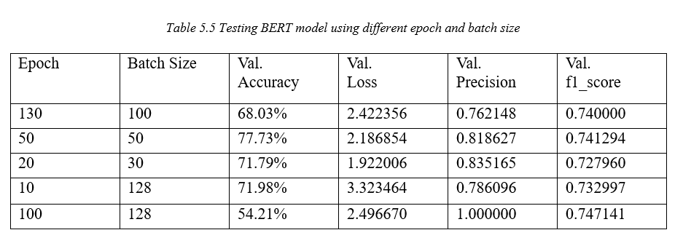
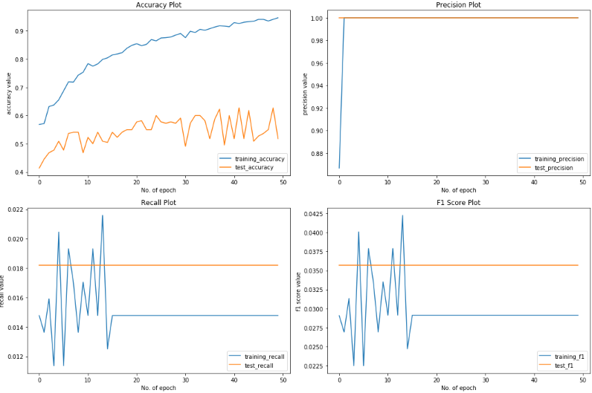
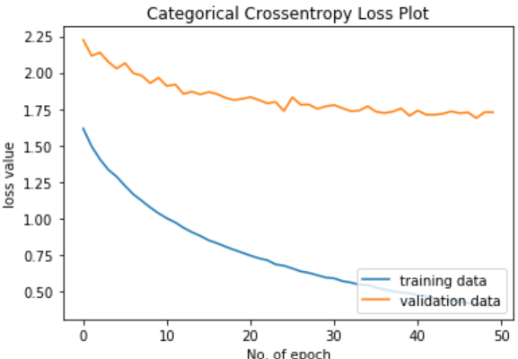
Regarding table 5.5, which assesses the effectiveness of the BERT model on test data, comparable fluctuations were noted for various combinations of epoch and batch size. For example, the model scored 68.03% validation accuracy with 2.422356 validation loss at 130 epochs and 100 batch size. The F1 score was 0.740000, and the precision was 0.762148. As a result of overfitting, the validation accuracy decreased to 54.21% with 100 epochs and a batch size of 128 while the validation precision increased to 1.000000.

Slide 26
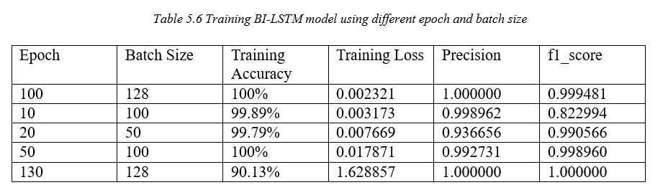
Bi-LSTM training
BI-LSTM Model Result Table
The Bi-LSTM model's training results are shown in table 5.6 for a variety of batch sizes and epoch combinations. "Epoch" indicates the number of training iterations, while "Batch Size" indicates the number of data samples handled in each training step. Each row represents a distinct training scenario. For example, the model achieved 100% training accuracy with a low training loss of 0.002241 at 100 epochs and a batch size of 128. The parameters for precision and F1 score were likewise excellent, coming in at 1.000000 and 0.999481, respectively. On the other hand, in 128 batches and 130 epochs, the accuracy remained high at 90.13%, but the training loss climbed dramatically to 1.628857, suggesting that overfitting may have occurred.

Slide 27
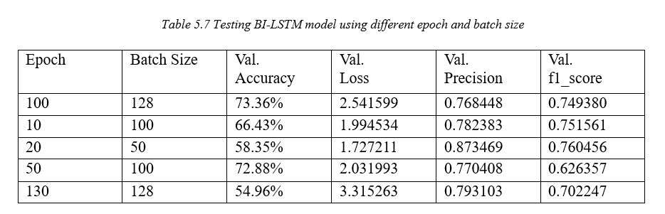
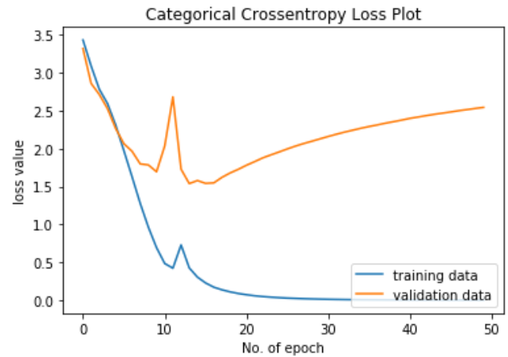
Regarding the table 5.7, which assesses the performance of the Bi-LSTM model on test data, a comparable pattern of fluctuations was noted for various batch size and epoch configurations. For instance, the model achieved a validation accuracy of 73.36% with a validation loss of 2.541599. This was done at 100 epochs and a batch size of 128. The F1 score was 0.749380, and the precision was 0.768448. On the other hand, the validation accuracy decreased to 54.96% with 130 epochs and a batch size of 128. This may indicate problems with generalization. These findings highlight how crucial it is to choose the right batch size and epoch combinations in order to maximize the Bi-LSTM model's performance on unknown data.

Slide 28


Conclusion
Our project is to develop an algorithm that can be used by natural language data analysis systems to understand mental health issues in patients. All users would need to do is describe their problem to the system as they would to a therapist, and it would use NLP techniques to process that explanation and categorize the user. A system like this has several applications. A counseling therapy provider may choose to have their patient complete an online initial evaluation to help them automatically match the patient with an appropriate therapist. This suggests that providers might be able to lower the cost of first assessments. Additionally, it might be applied to mental health counseling software, which analyzes patients' natural language descriptions of their problems to try and unite them. Categorizing every discussion that patients have on the application would also make it easier for the application to keep track of all the problems that patients have.
This Photo by Unknown author is licensed under CC BY-NC-ND.
This Photo by Unknown author is licensed under CC BY-SA.

Slide 29
Future Work
There is always room for improvement in the performance of the T5 model used for mental health issue classification. This may involve exploring new architectures, such as hybrid models that combine T5 with other deep learning techniques, or improving the feature extraction process. Additionally, Future work should focus on creating models that are more resilient and culturally and linguistically sensitive. Another important area of future work is cross-disciplinary research that brings together experts in NLP, mental health, and related fields. Such research can explore novel applications of T5-based approaches to mental health issues, such as the early detection of mental health issues, predicting suicide risk, and developing personalized treatments based on patient data. This type of research can help bridge the gap between technology and clinical practice and provide innovative solutions to mental health issues. Overall, the future work for The use of NLP to classify mental health concerns using T5-based approaches is a promising method that has numerous prospects for future research and advancement. As NLP technology continues to advance, T5-based approaches will likely become more widely used in mental health research and clinical practice.

Slide 30

Guide Approval mail snapshot

Slide 31

Research Paper Status
Submitted according to the guide research paper as per the format of the journal/conference. The guide was also submitted to the journal.

Slide 32

References
B. Shickel, M. Heesacker, S. Benton and P. Rashidi, "Automated Emotional Valence Prediction in Mental Health Text via Deep Transfer Learning," 2020 IEEE 20th International Conference on Bioinformatics and Bioengineering (BIBE), Cincinnati, OH, USA, 2020. (IEEE)
Dongkeon Lee, Kyo-Joong Oh, and Ho-Jin Choi, "The chatbot feels you - a counseling service using emotional response generation,(BigComp), Jeju, Korea (South), 2021. (IEEE)
Syarif, N. Ningtias and T. Badriyah, "Study on Mental Disorder Detection via Social Media Mining," 2019 4th International Conference on Computing, Communications and Security (ICCCS).2022(IEEE)
Y. Aryal, A. Maag and N. Gunasekera, "Application of Machine learning algorithms in diagnosis and detection of psychological disorders.(IEEE)-2020.
Tanya Nijhawan, Girija Attigeri & T. Ananthakrishna,Stress detection using natural language processing and machine learning over social interactions, 2022(Springer).
Aziliz Le Glaz, Yannis Haralambous, Deok-Hee Kim-Dufor,1 Philippe Lenca, Romain Billot, Taylor C Ryan, Jonathan Marsh, Jordan DeVylder, Michel Walter,1, Sofian Berrouiguet, Christophe Lemey,Machine Learning and Natural Language Processing in Mental Health,2021(Jounral of medical internet research).

Slide 33
References
Young, T., Hazarika, D., Poria, S. and Cambria, E., 2018. Recent Trends in Deep Learning Based Natural Language Processing, ArXiv, 2020(IEEE).
M. Hoogendoorn, T. Berger, A. Schulz, T. Stolz and P. Szolovits, "Predicting Social Anxiety Treatment Outcome Based on Therapeutic Email Conversations," in IEEE Journal of Biomedical and Health Informatics, vol. 21, no. 5, pp. 1449-1459, Sept.(2022)
Tholusuri, A., Anumala, M., Malapolu, B. and Lakshmi, G.J., 2019. Sentiment Analysis using LSTM, International Journal of Engineering and Advanced Technology, 8(6S3), pp. 1338 1340.(IJEAT)
Su, M., Wu, C., Huang, K and Hong, Q., 2018. LSTM-based Text Emotion Recognition using Semantic and Emotional Word Vectors, First Asian Conference on Affective Computing and Intelligence Interaction,2020(ACII Asia).
Mikolov, T., Chen, K., Corrado, G. and Dean, J., 2013. Efficient Estimation of Word Representations in Vector Space, ArXiv,2020 (IEEE).
K. M. Hasib et al., "MCNN-LSTM: Combining CNN and LSTM to Classify Multi-Class Text in Imbalanced News Data," in IEEE Access, vol. 11, pp. 93048-93063, 2023, doi: 10.1109/ACCESS.2023.3309697. (IEEE).
B. C. Loftness et al., "Toward Digital Phenotypes of Early Childhood Mental Health via Unsupervised and Supervised Machine Learning," 2023 45th Annual International Conference of the IEEE Engineering in Medicine & Biology Society (EMBC), Sydney, Australia, 2023, pp. 1-4.

Slide 34
References
Bigi, B., 2014. A multilingual text normalization approach. Human Language and Technology Challenges for Computer Science and Linguistics, vol. LNAI-8387, pp. 515-526(IEEE) -2020.
H. K. Marrapu, B. Maram and P. Reddi, "New Analytic Framework of Public Mental Health Prediction Using Data Science," 2022 International Conference on Smart Technologies and Systems for Next Generation Computing (ICSTSN), Villupuram, India, 2022, pp. 1-6, (IJEAT).
Neha S, Shekar P H C., Kumar K S., and Vg A, ―Emotion recognition and depression detection using deep learning,‖ pp. 3031–3036, 2020. (Springer)
Calvo, R. A., Milne, D. N., Hussain, M. S., & Christensen, H. (2017). Natural language processing in mental health applications using non-clinical texts. Natural Language Engineering, 23(5), 649–685.(IEEE)
Abha Tewari, Amit Chhabria, Ajay Singh Khalsa, Sanket Chaudhary, Harshita Kanal, ‘A Survey of Mental Health Chatbots using NLP,2021. (IEEE)
Tanya Nijhawan, Girija Attigeri & T. Ananthakrishna, Stress detection using natural language processing and machine learning over social interactions, 2022.(IEEE)
Young, T., Hazarika, D., Poria, S. and Cambria, E., 2018. Recent Trends in Deep Learning Based Natural Language Processing, ArXiv, 2020.
Dataset https://counselchat.com/

Slide 35

Thank you

